Slide 1
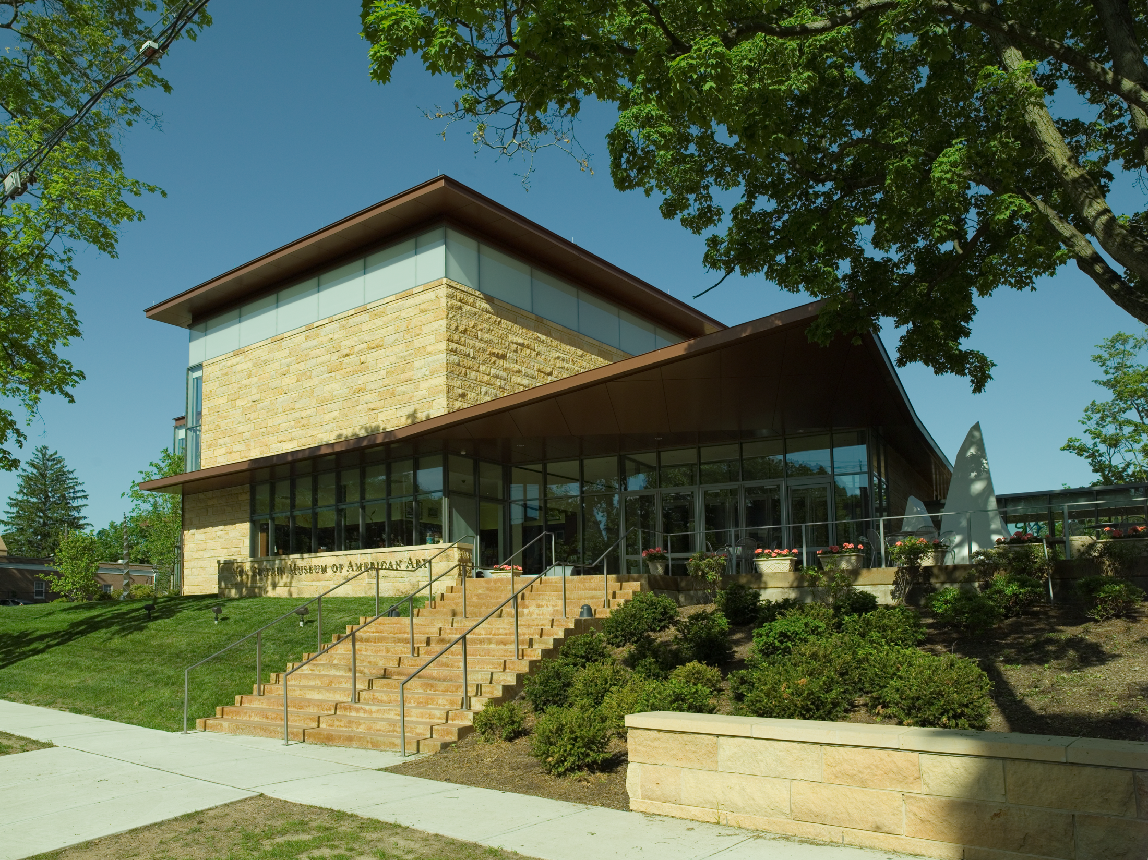
THINK Like an Artist
Artists possess a critical eye that shapes the way they make and look at art. Let students assume the role of art critic as they learn how to analyze specific works in depth, from initial observations, to well thought-out interpretations, to final assessments. Listen to and learn from each other, expressing and evaluating ideas about thought-provoking artworks from the past and present.

Slide 2
Note to Teachers
Use this PowerPoint in the classroom to prepare your students for their visit to the Museum.
While each of your students will not see all of the artworks included here, they will all have similar conversations with their docents.
Spend as much time looking at the artworks in this PowerPoint as you can. Even a quick viewing will make for a richer, more memorable museum visit.
For more collection images, visit our eMuseum site on nbmaa.org, under “Educational Resources.”

Slide 3
How to be an art critic: Describe, Analyze, Interpret, Evaluate
A critique is an oral or written discussion strategy used to analyze, describe, and interpret works of art. It can help students to hone skills of persuasive communication, information-gathering, and justification. Try the following questions as you look at the artworks here to lead your own critique session.
Describe the work without using value words such as “beautiful” or “ugly.”
Analyze how the work is organized as a complete composition. Do you see elements (lines, colors, shapes, etc.) that get repeated throughout the work? What parts of it stand out the most? If it has subjects or characters, how do they relate to each other?
Interpret the work by describing how it makes you think or feel. Does it remind you of anything you have experienced?
Evaluate the work by presenting your opinion of it. Do you like it? Why or why not? How does it compare to other artworks that you’ve looked at?

Slide 4
How to be an art critic: The TABULA Approach
T Take some time to really look at the artwork.
A What associations does it have for you? Does it remind you of something? Is it familiar at all?
B What can you find out about the background of the work, or the artist who made it?
U Do you have a better understanding of it now?
L Look at it again. Do you notice anything new?
A Go ahead and assess the artwork now. Do you like it? Why or why not?
Notes:
Source: Ossian Ward, Ways of Looking: How to Experience Contemporary Art (London: Laurence King Publishing, 2014)

Slide 5
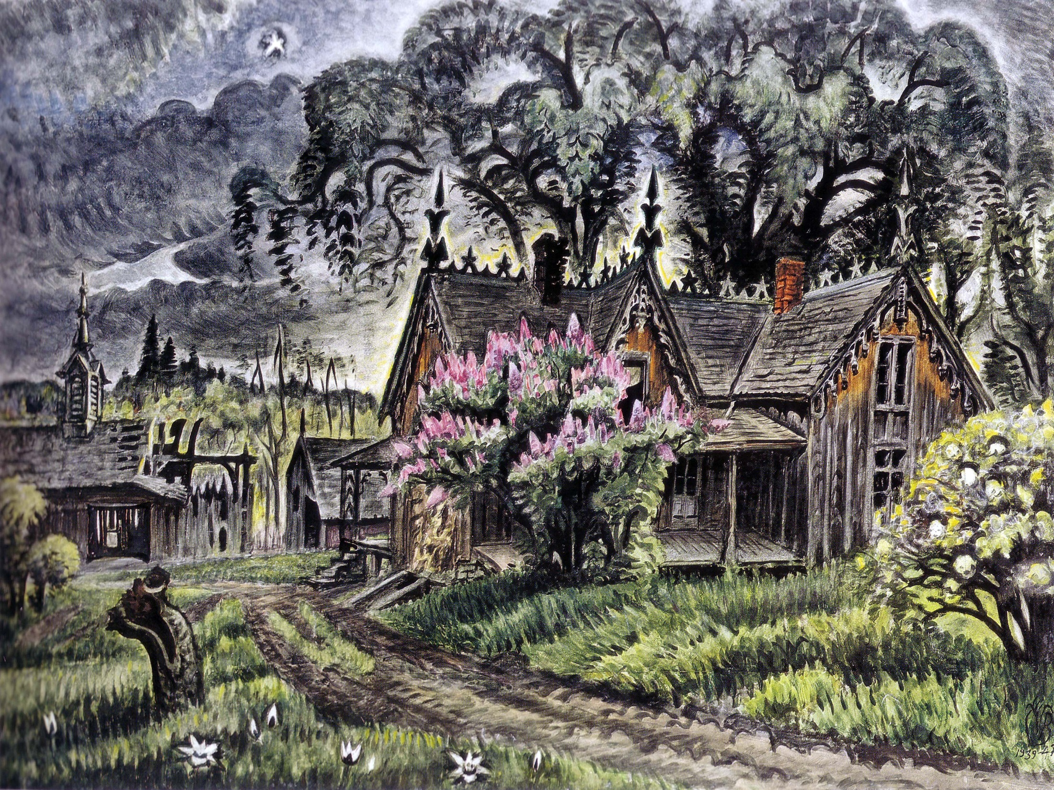
Notes:
Charles E. Burchfield (1893-1967), Lavender and Old Lace, 1939-1947, watercolor on paper, NBMAA (1952.29)

Slide 6
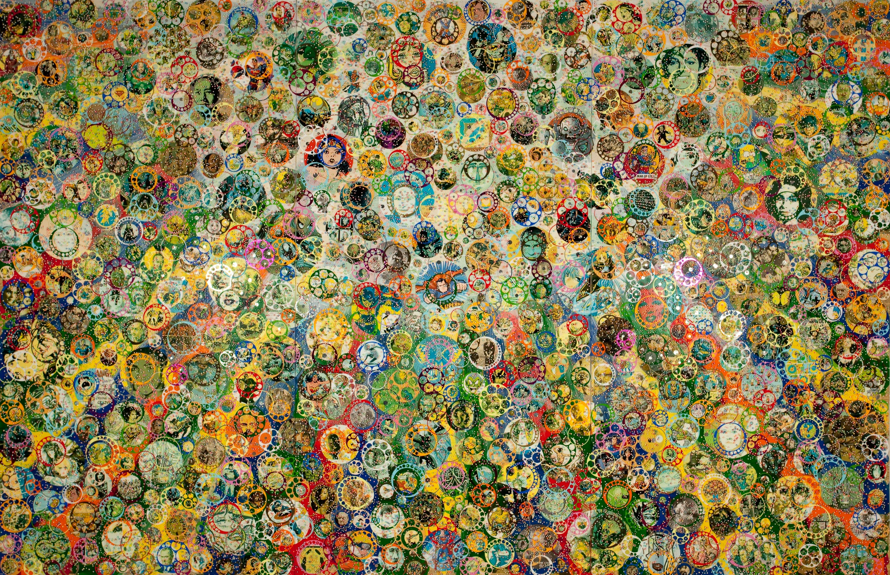
Notes:
Nobu Fukui (born 1942), Incredulity, 2012, mixed media on canvas over panel, NBMAA (2014.04)

Slide 7
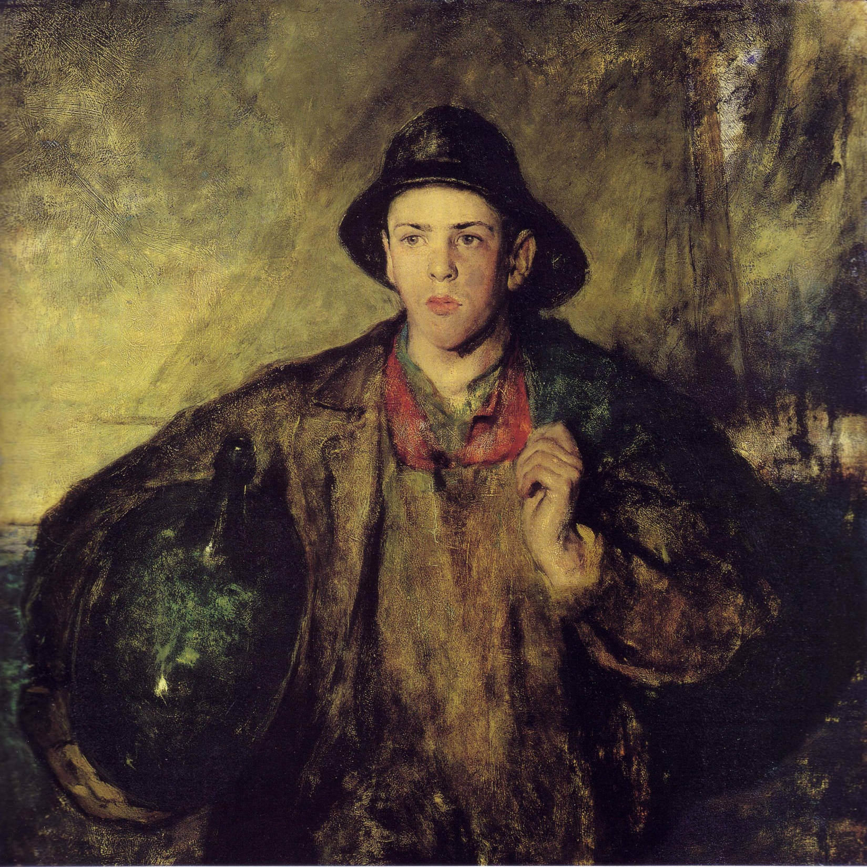
Notes:
Charles Webster Hawthorne (1872-1930), The Fisher Boy, ca. 1906, oil on canvas on board, NBMAA (1912.02)

Slide 8
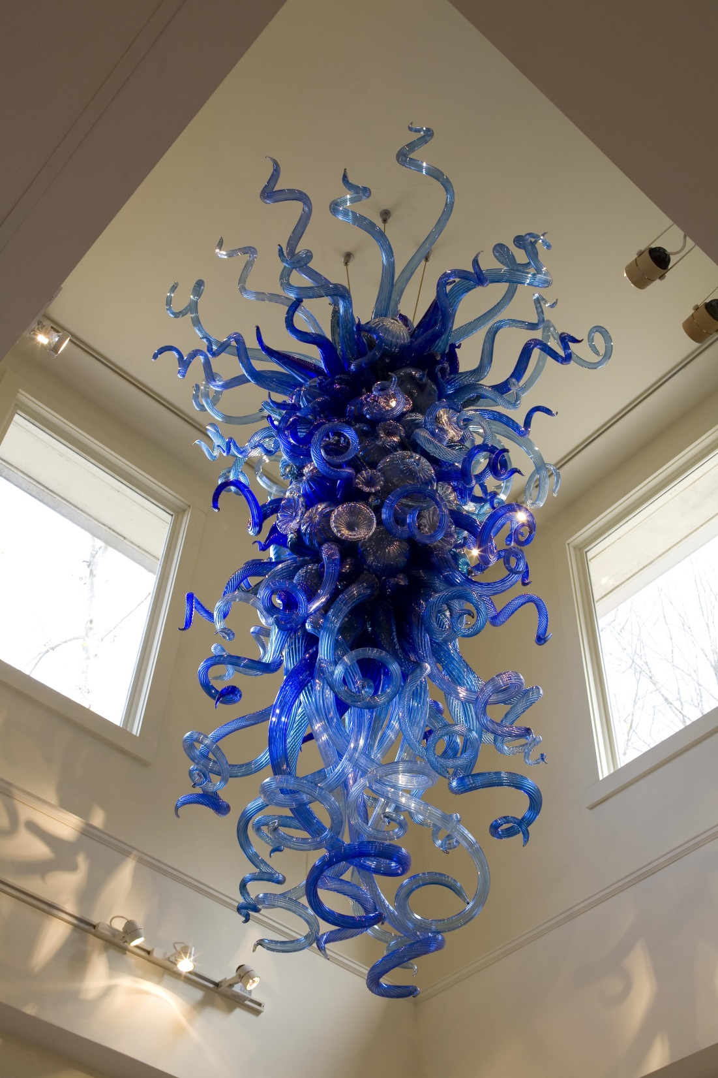
Notes:
Dale Chihuly (born 1941), Blue and Beyond Blue, 2006, glass, NBMAA (2007. 127)

Slide 9
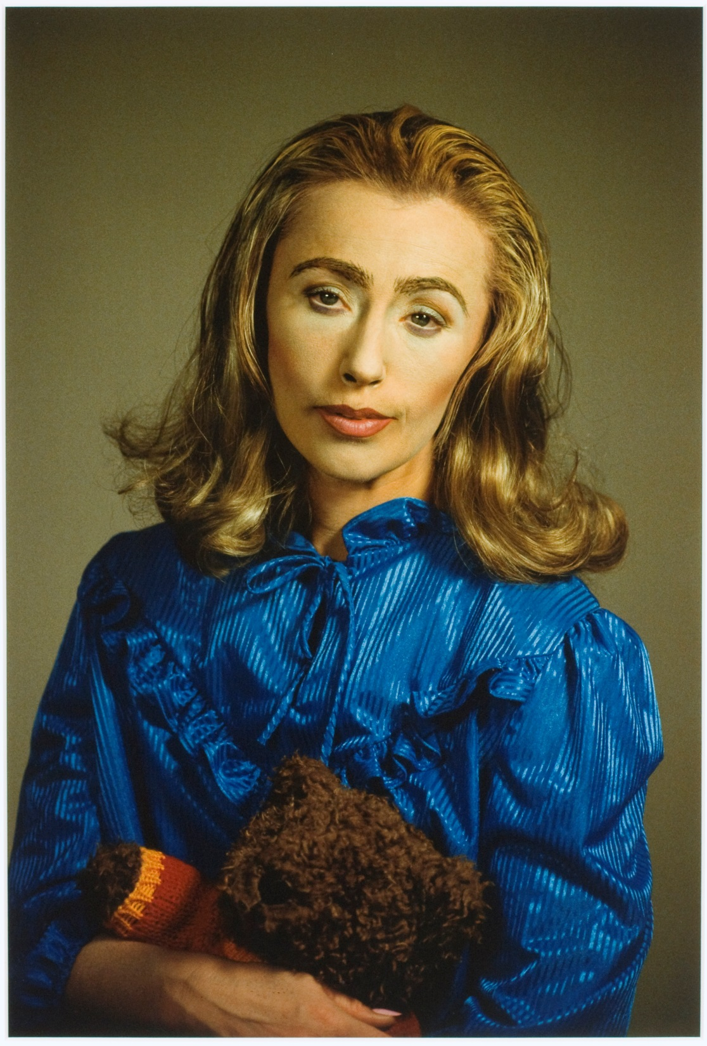
Notes:
Cindy Sherman (born 1954), Untitled, 2000, cibachrome print, NBMAA (2000.88)

Slide 10
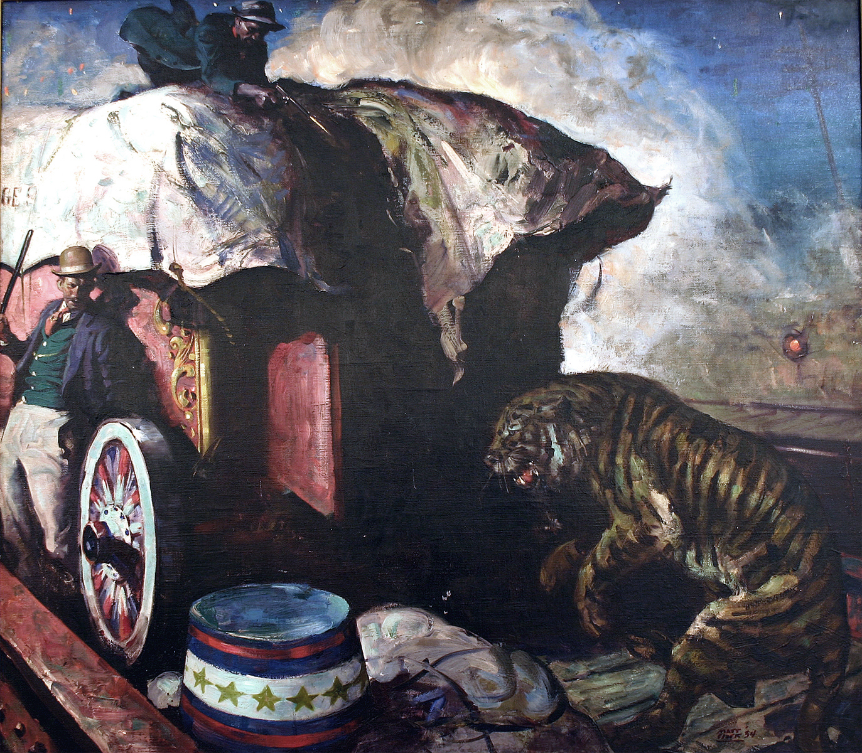
Notes:
Matt Clark (1903-1972), Circus Capture, 1934, oil on canvas, NBMAA (1966.60 LIC)

Slide 11
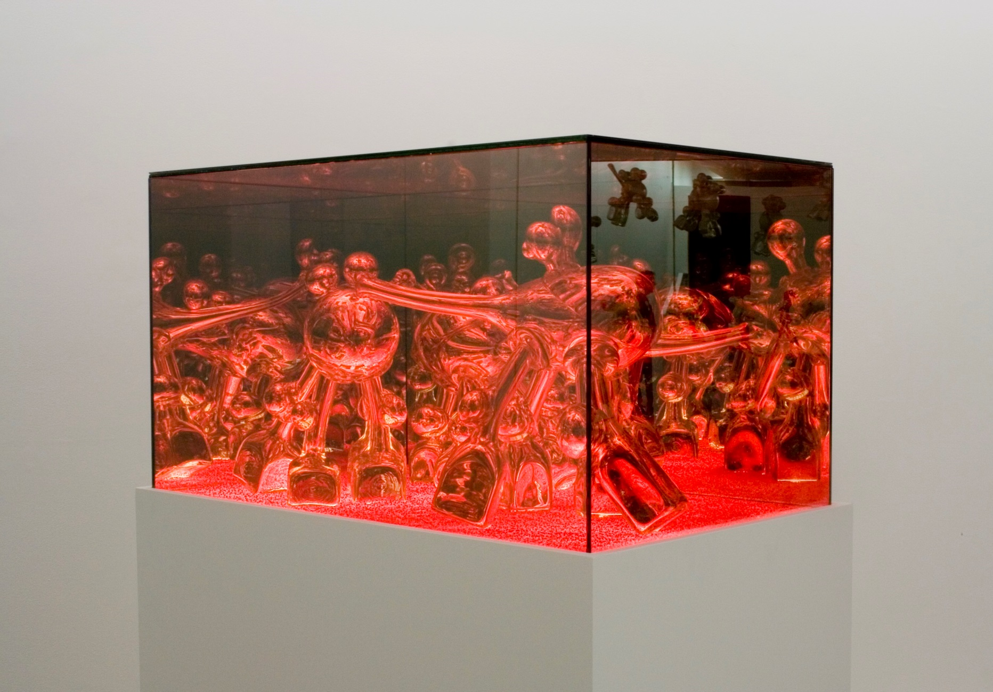
Notes:
Andrew Erdos (born 1985), Cheerfully Rooting through Ruby Red Detritus, 2013, mouth-blown silverized glass, two-way mirror, colored crystal, LED lights, Courtesy of Claire Oliver Gallery, New York, NY

Slide 12
After Your Visit
Revisit the artworks in this PowerPoint, and have students share what they learned about each one.
Ask students to draw and/or describe their favorite artwork at the Museum.
Have students research any questions or issues that arose on their visit.
Ask students to write letters to the Museum about their experience. Send to: Education Department, NBMAA, 56 Lexington St., New Britain, CT 06052
Encourage students to return with their families, reminding them that the Museum is free to visit on Saturday mornings, from 10 a.m. until noon.

